Slide 1



NASA Symposium 2015
Pima Community College
April 18, 2015
Team Members
Nicholas Patzke
Gustavo Guerrero

Slide 2
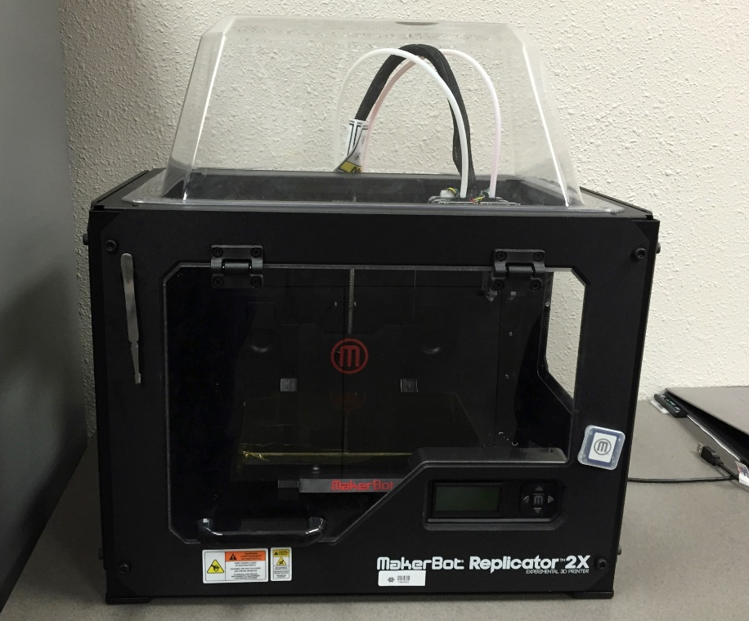
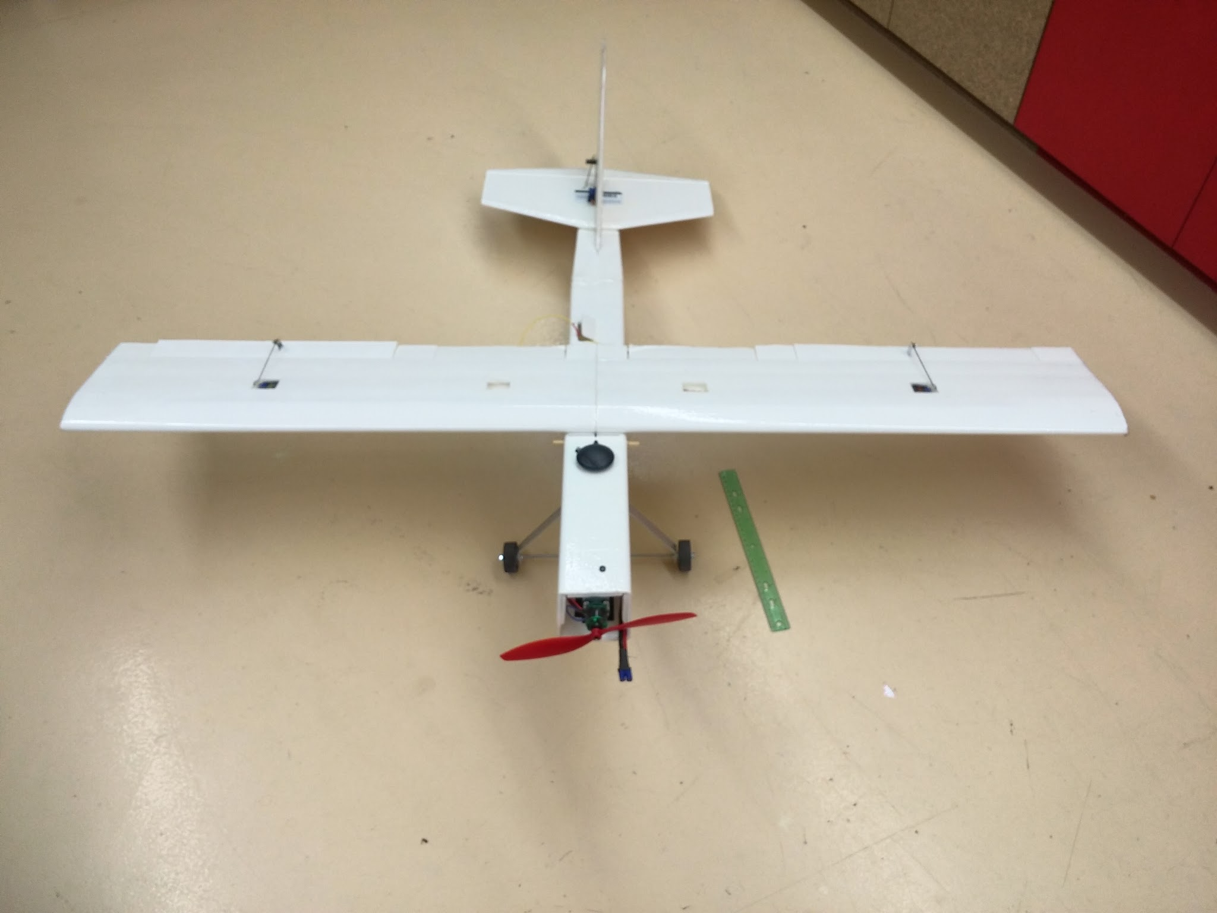
Our Projects
MakerBot Replicator 2X
Fixed Wing UAV

Slide 3
Part 2:
The Fixed Wing
UAV

Slide 4
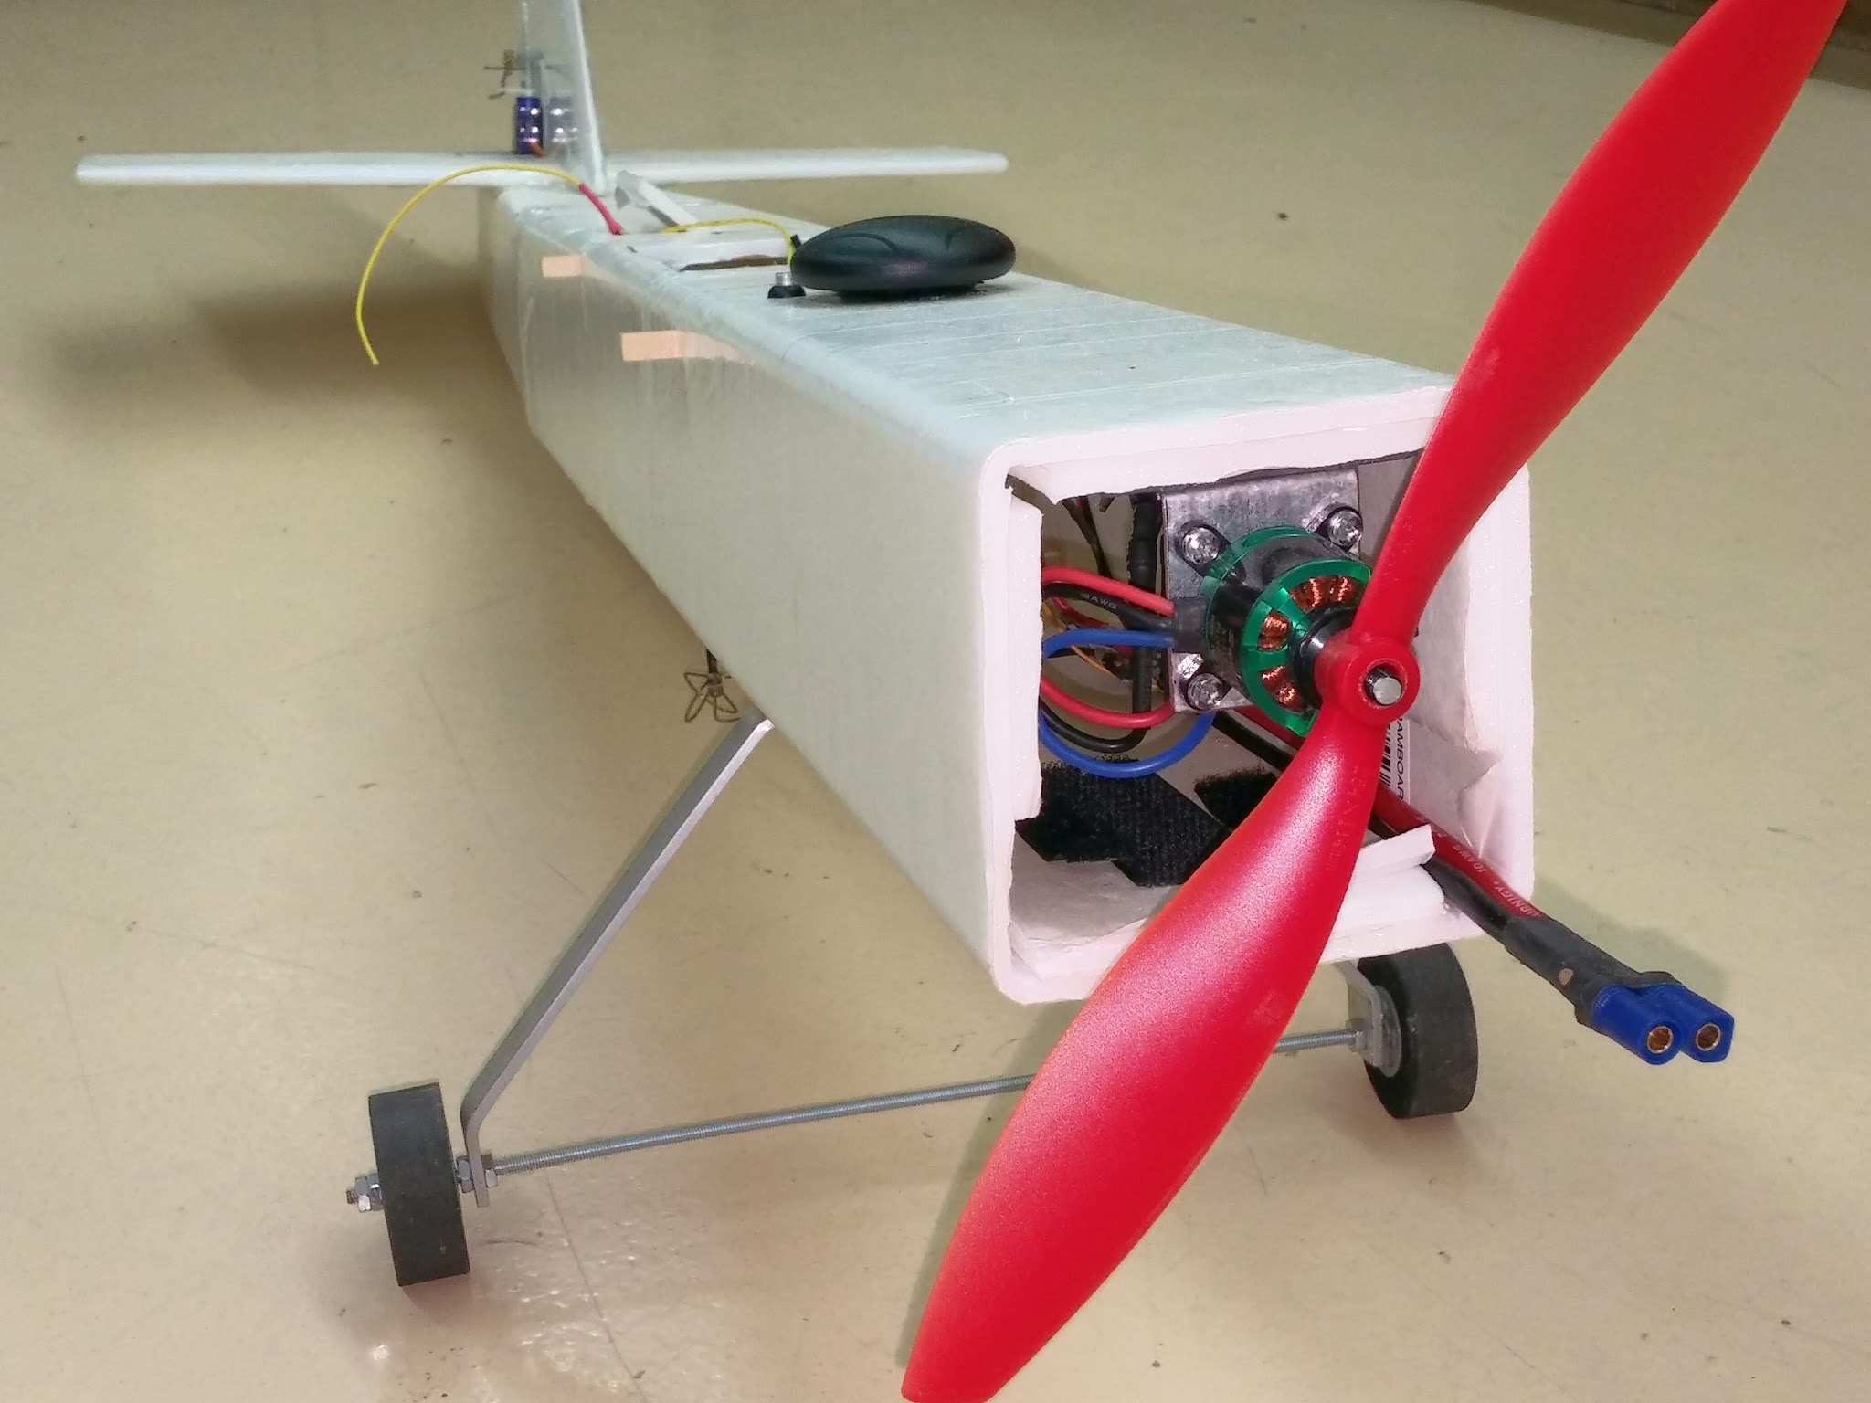
Fixed Wing UAV Prototype
Motivation:
Needed an aircraft capable of carrying heavy payloads and longer flight.
Proof of Concept
Trainer (something to crash)
A Physical Model
  To test electronics and hardware

Slide 5
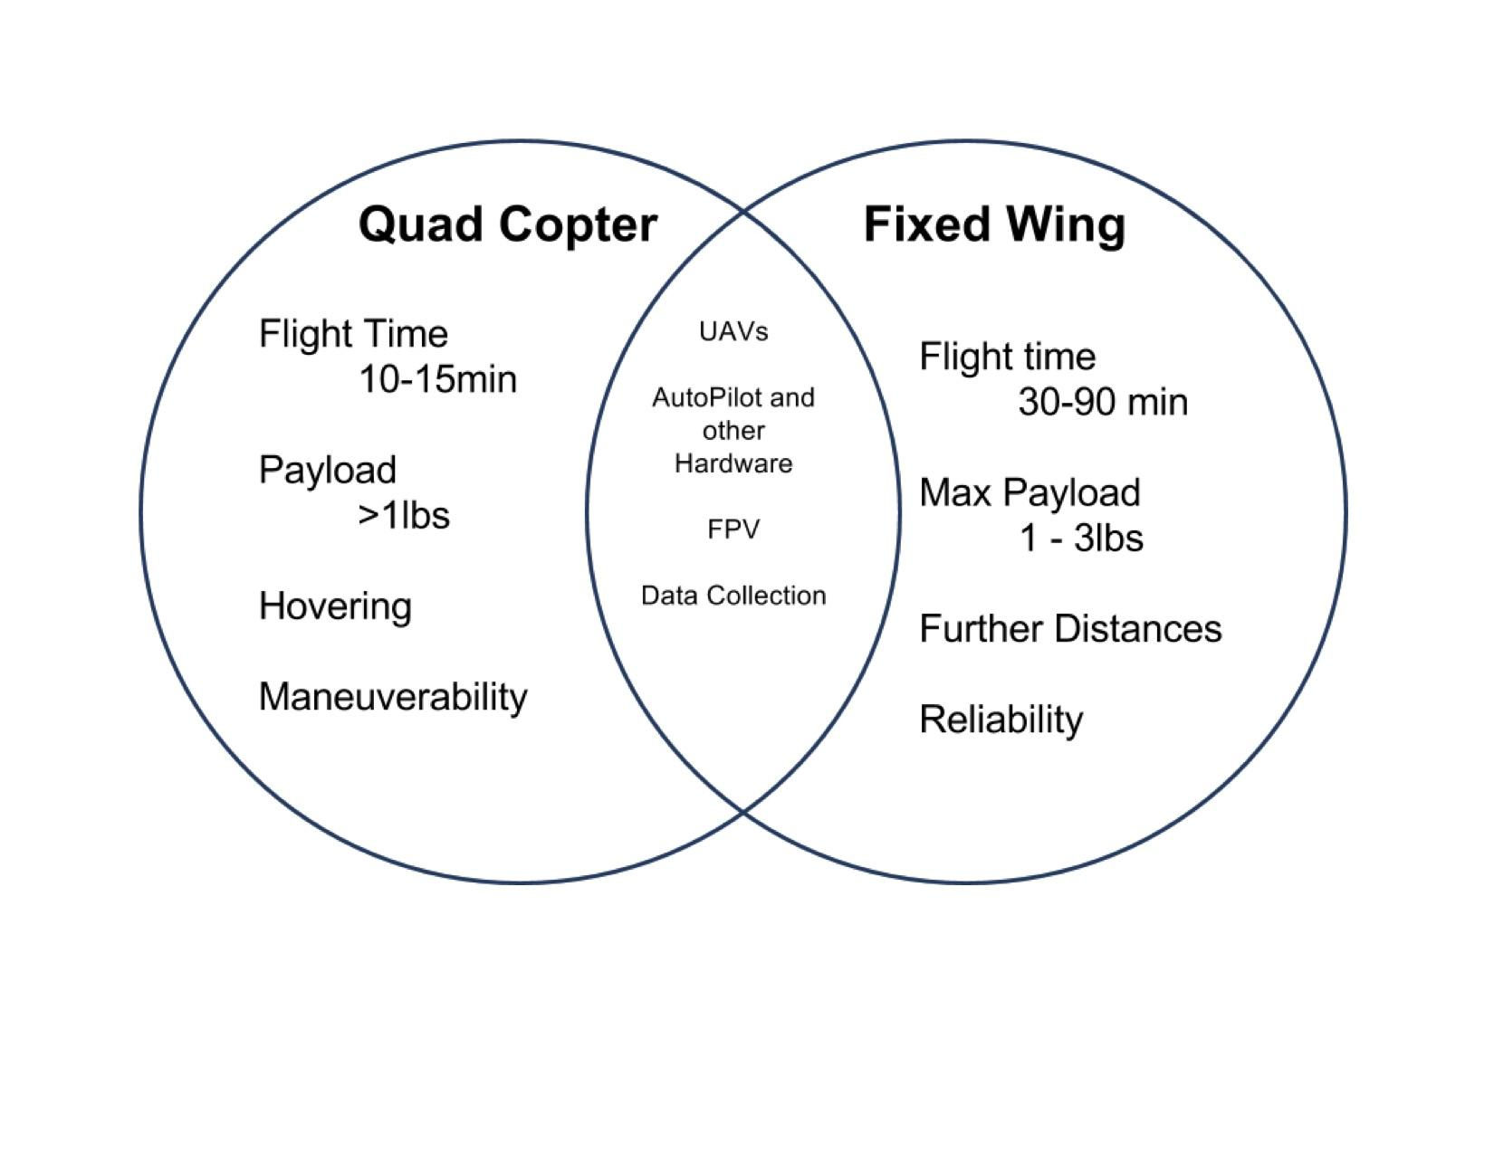
Quad vs Airplane

Slide 6
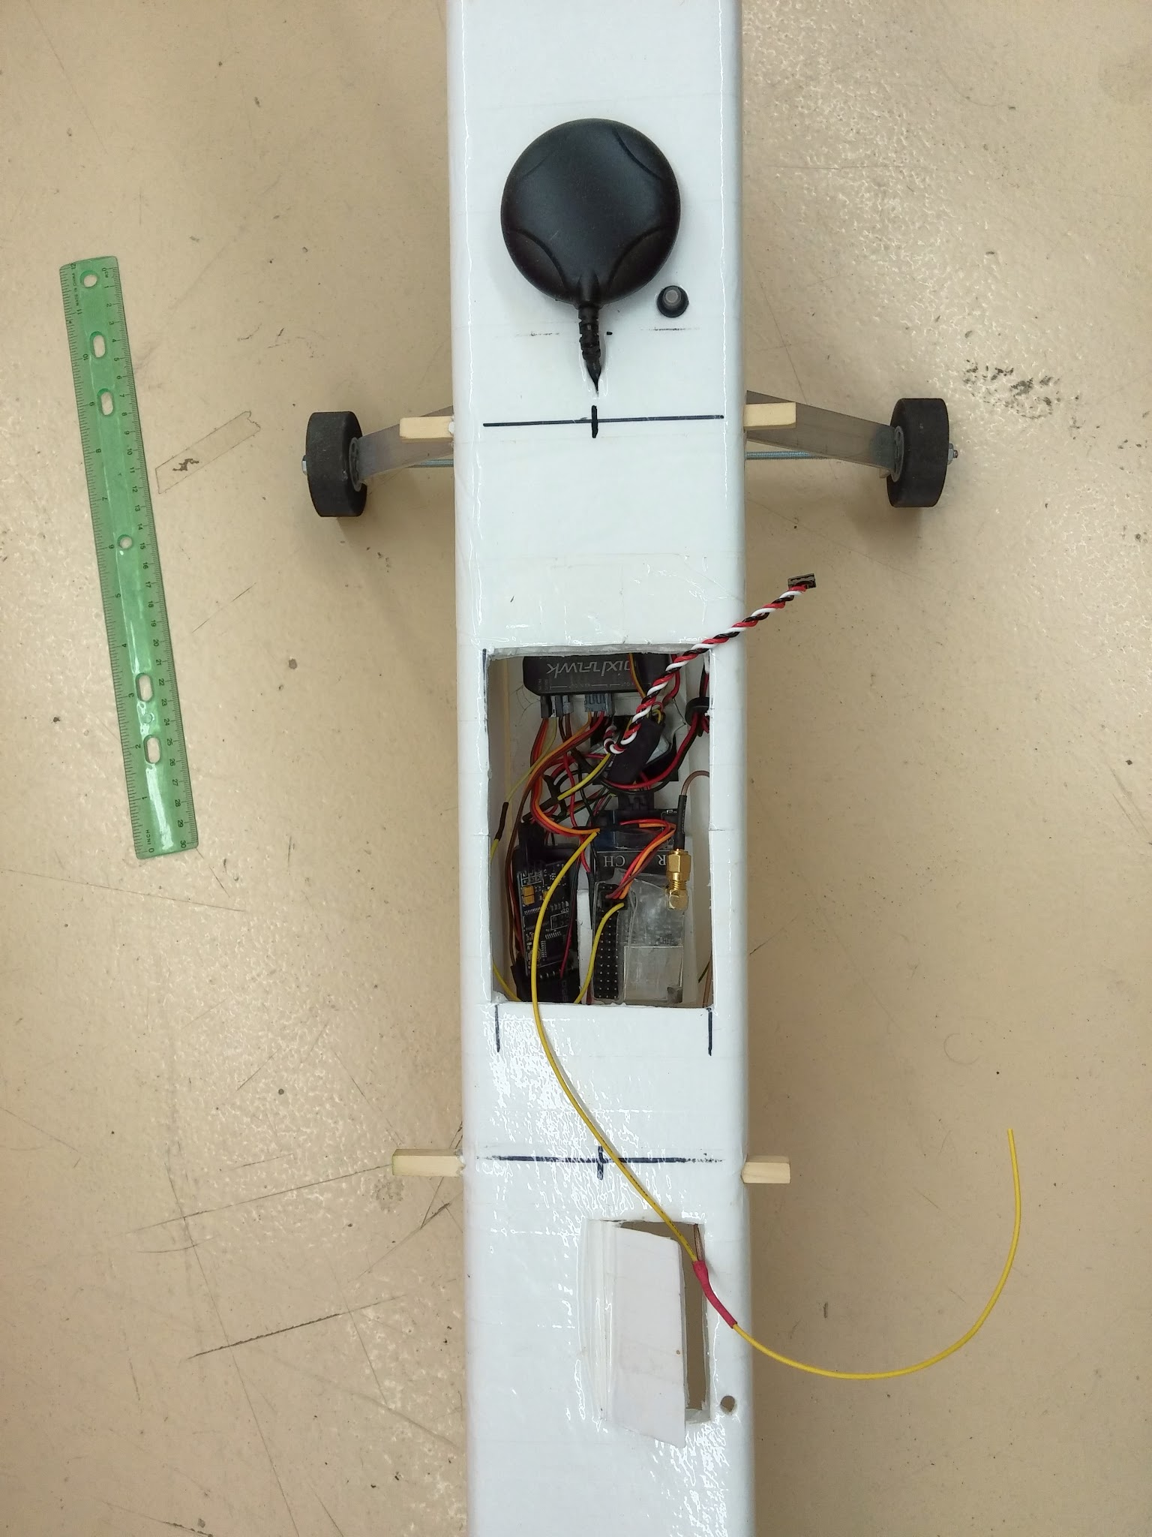
Hardware
Autopilot: 3DR Pixhawk
    Barometer, IMU
    Arduino based processing
GPS/Compass
RC: RangeLink LRS
5.8ghz video transmitter
Video OSD (Data Overlay)
GoPro
Wireless telemetry
LC filter
5v/3A regulator
30A ESC (motor controller)
1200kv electric motor
6.4aH battery
4x 9g servos

Slide 7
Potential Uses
Mapping
  Agriculture
  Construction
  Resource Management
Emergency Response
Science/Education
  Data collection
Enjoyment

Slide 8
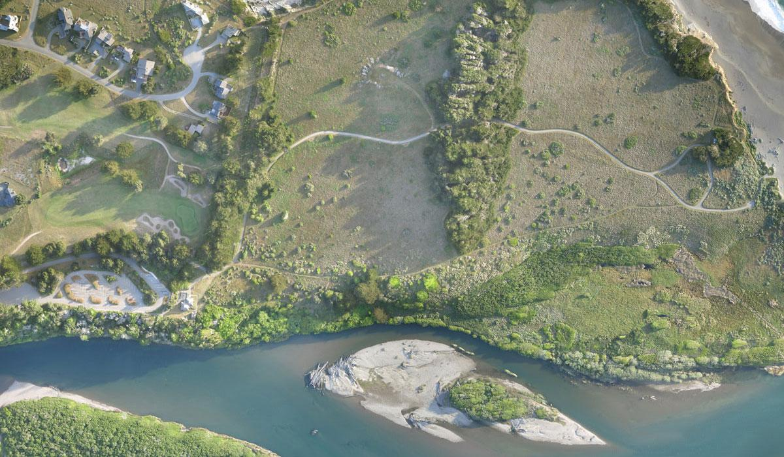
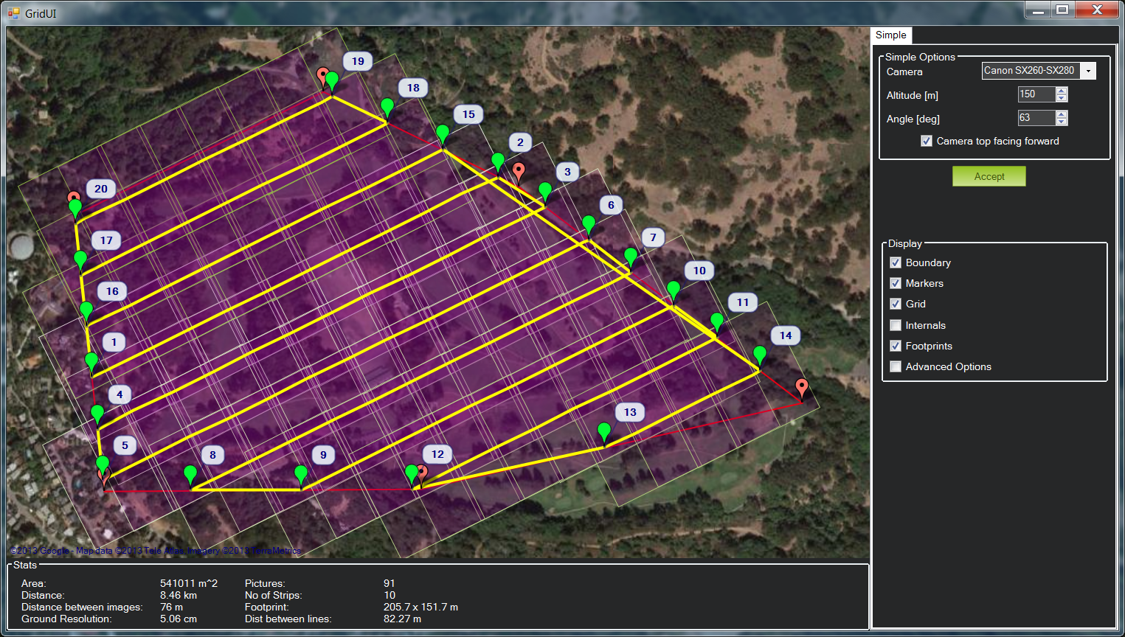
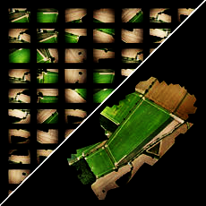

Slide 9
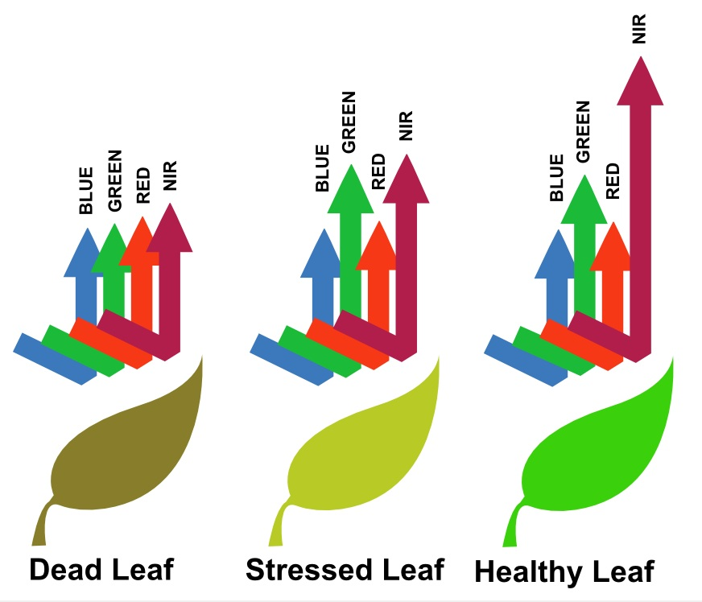
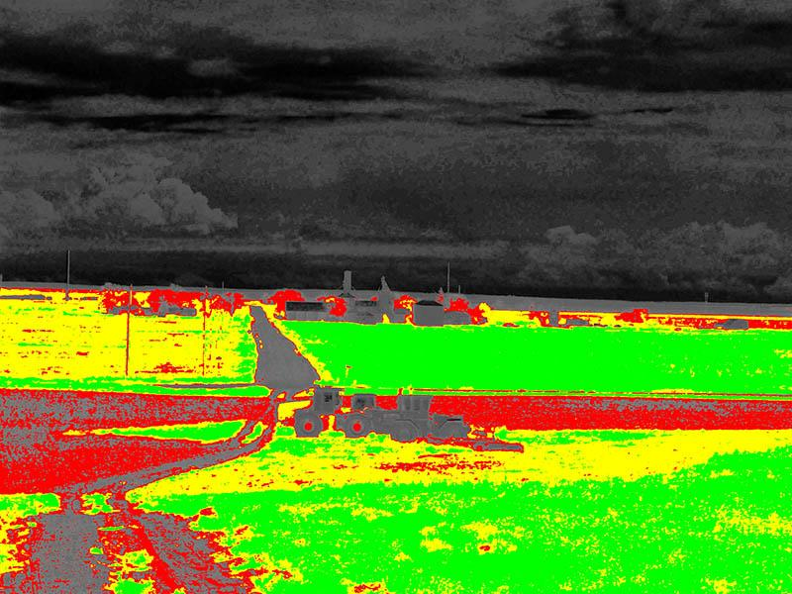
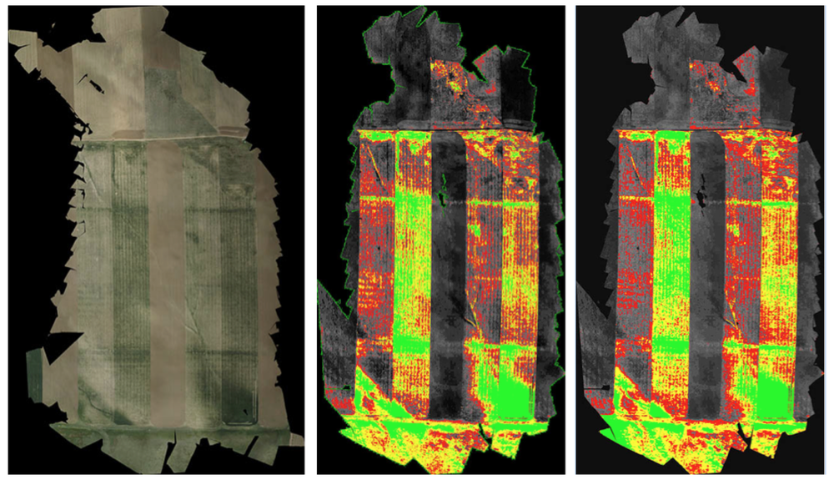
NDVI Examples

Slide 10
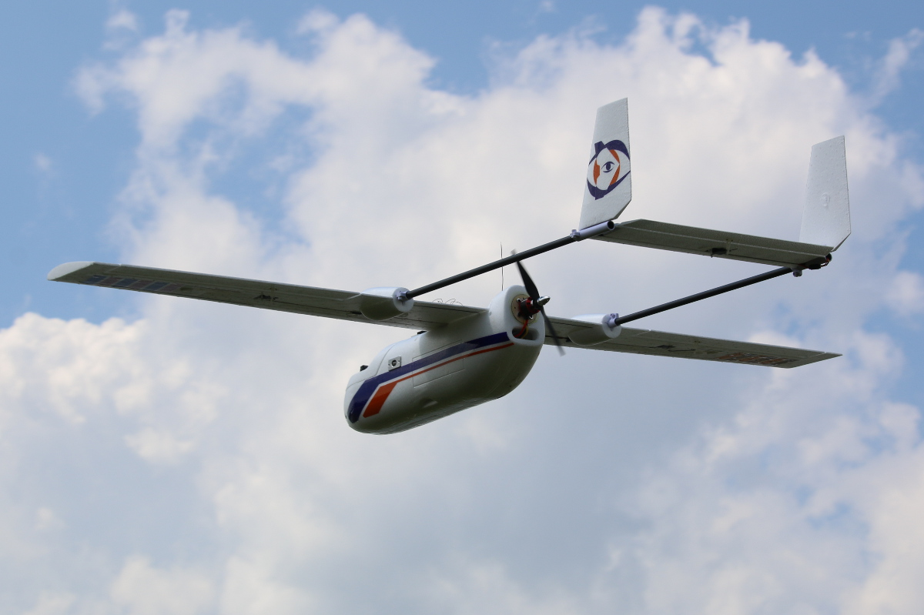
Future Airframe
1.8m wingspan
Large fuselage compartment
EPO foam

Slide 11
UAV Prototype Conclusion
All electronics are functioning as expected
Continue testing/configuring autopilot and mapping hardware
Transplant electronics to new airframe

Slide 12
Acknowledgements
Special thanks to the following
Susan Brew and NASA Space Grant
Jack Crabtree and ANSR
Silvia Kolchens
Mike Sampogna
Mike Tveten

Slide 13
Picture Credits
Map Background
Ready Made RC http://www.readymaderc.com/
Mapping Samples
Pix4D https://pix4d.com/applications/
NDVI Pictures
Agrobotix http://agribotix.com/
Sailfish firmware and ReplicatorG software
Open Source http://www.thingiverse.com/thing:32084
Replicator 2X Background
MakerBot http://www.makerbot.com/

